Slide 1

FISH TANK
Swim with the Big Fish — Even on a Small Budget.
By: Evan Perea, Bradley Widulski, Michael Vythilengam, Thanh Mai
The Investment Shoal

Slide 2

Existing Products
Venmo
CashApp
Public.com
Zogo Finance
GoFundMe
NFTs

Slide 3
What are users looking for?
Group Behavior and a sense of Community
Gamification
Emotion
Low entry barrier

Slide 4
Underserved Areas
Group Investing
Collective Savings
Microlending/Peer-to-peer Credit

Slide 5
Layout
Business/Entrepreneurs
Investors
What is Fish Tank?
Benefits for Entrepreneurs
Investment Models
Fraud Prevention
Tiers
Support
Differentiation from existing products
What is Fish Tank?
Benefits for Investors
Types of Investments
Investor Protection
Risks and Rewards
Manage your Money

Slide 6
What is Fish Tank for Entrepreneurs?
Get funding from retail investors
Fish Tank helps you find investors for your startup! From food trucks to the next Facebook, any business can flourish on Fish Tank!
An easy way to start up your business
Fish tank will help you set up a compliant and solid company so that you can focus on what you do best
Build your business with community support
Use our community to fund your business and dreams! With major success you can also help your investors.

Slide 7
Benefits for Entrepreneurs
Focus on building, not chasing funding
Access startup capital from many small investors
Metrics dashboard to monitor performance
Compliance support: taxes, legal structure, reporting
More control over your business

Slide 8
Fraud Prevention
Verified entrepreneurs only (ID and business entity)
Funds held securely in escrow
Spending approvals ensure investor trust
Auditable business records

Slide 9
Investment Models
Fixed returns
Revenue-based returns
Percentage ownership

Slide 10

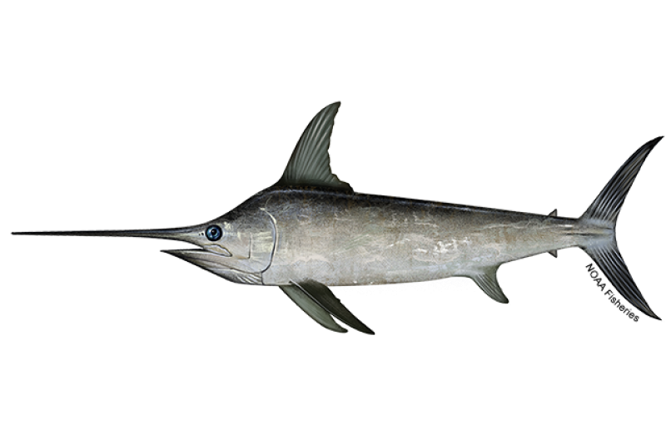
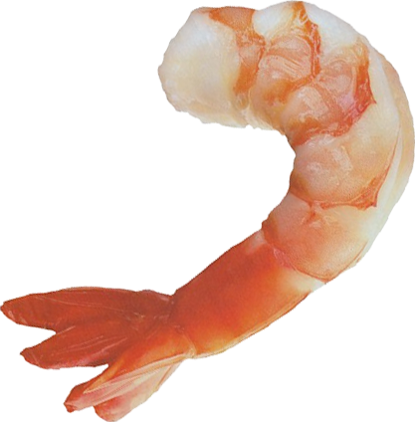
Tiers
Shrimp
Swordfish
Shark
Intermediate Tier
Funding capped at 5k per investor
Can offer percentage returns
Basic Tier
Funding capped at 1k per investor
Can offer fixed returns
Advanced Tier
Funding capped at 10k per investor
Can offer percentage ownership

Slide 11
Differentiation From Existing Products
Robinhood
Only allows investing in businesses (stocks) that are already on the market
GoFundMe
No expectation of returns, typically for single products or charity

Slide 12

Support
Business setup help (LLC, tax ID, licensing)
Ongoing compliance monitoring
Escrow-managed disbursement = safety for you and investors

Slide 13
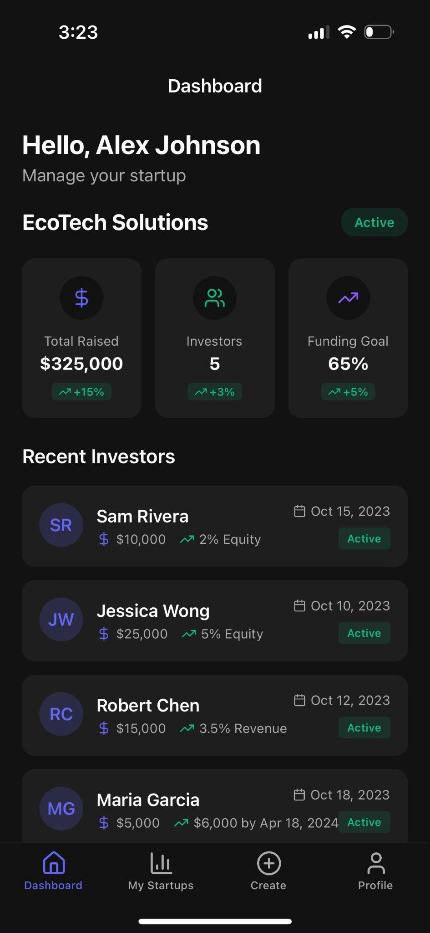
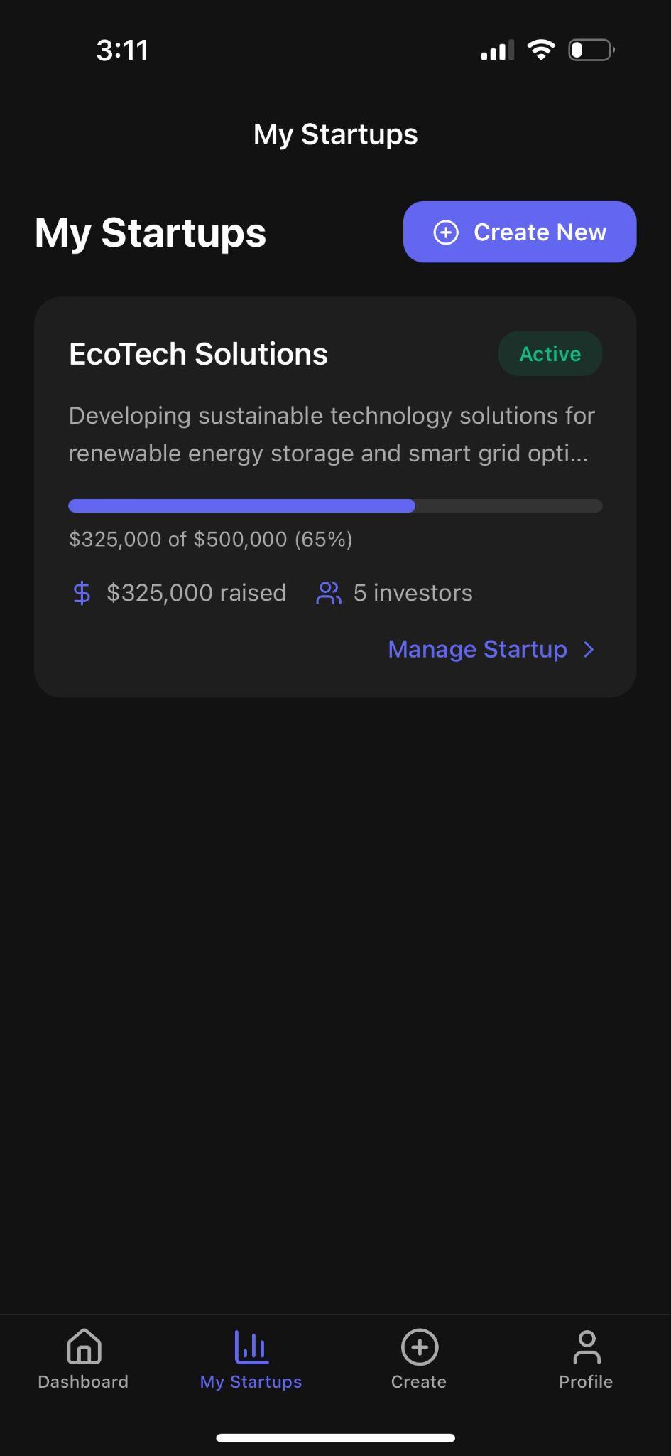
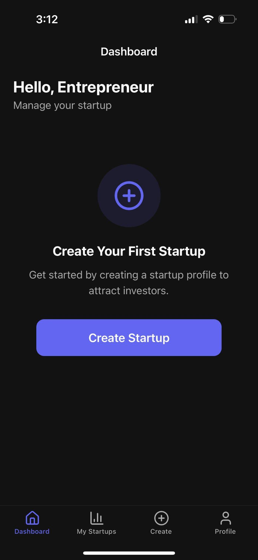

Slide 14
What is Fish Tank for Investors?
Invest in real startups at early stages
This is a great opportunity for everyday people to invest their money. Plus diversify their portfolio from stocks and have another way of making money.
Small investments = big potential
The small investments at the beginning of the startup can lead up to large sum of money depending if the business is successful.
Community-driven investment platform
Allows you to speak to the owners and speaking about their projects and business models. This makes it easy to communicate with each other and have a community to back up the business.

Slide 15
Benefits for Investors
Potential for real financial returns
Community forums to discuss investments
Influence startups through direct feedback

Slide 16
Types of Investments
Own a % of a business.
If the company grows your equity increases in value.
For example $100 = 0.01% ownership in the startup.
Fixed return payouts based on milestones
Example is investing $100 and you will get $150 when the company earns $50.000
Revenue-sharing models.
Depending on the company performance.
For example 3% of the revenue until you earn 1.5x your investment.

Slide 17
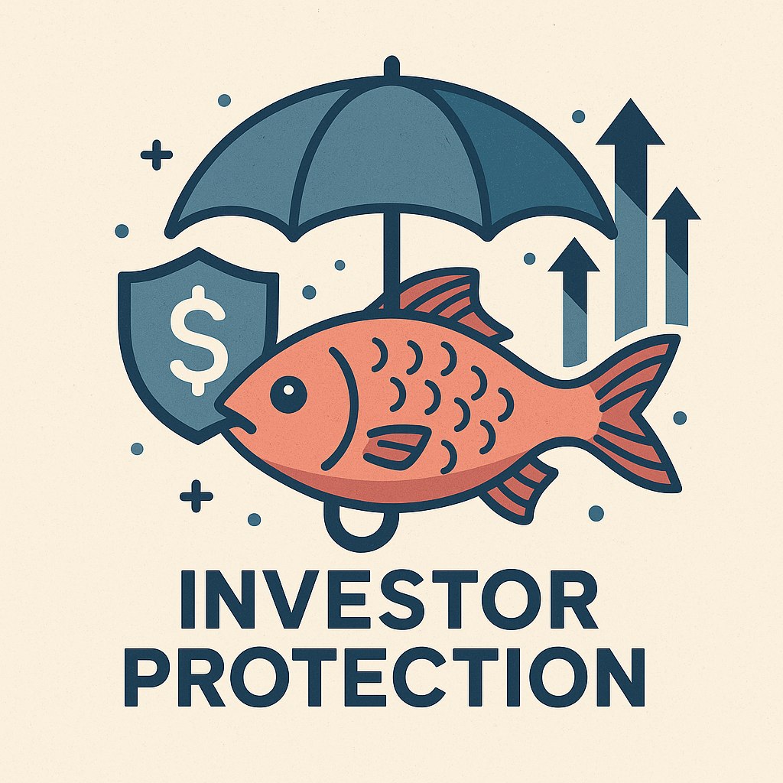
Investor Protection
Verified entrepreneurs only
Escrow accounts safeguard your money
Strict approval process = credible startups
Fraud detection and legal protection in place

Slide 18
Risks and Rewards
Risks
Rewards
Loss of Investment
Lack of Liquidity
Full refund if fraud occurs
Early Access Opportunities
Financial Return
Diversification

Slide 19
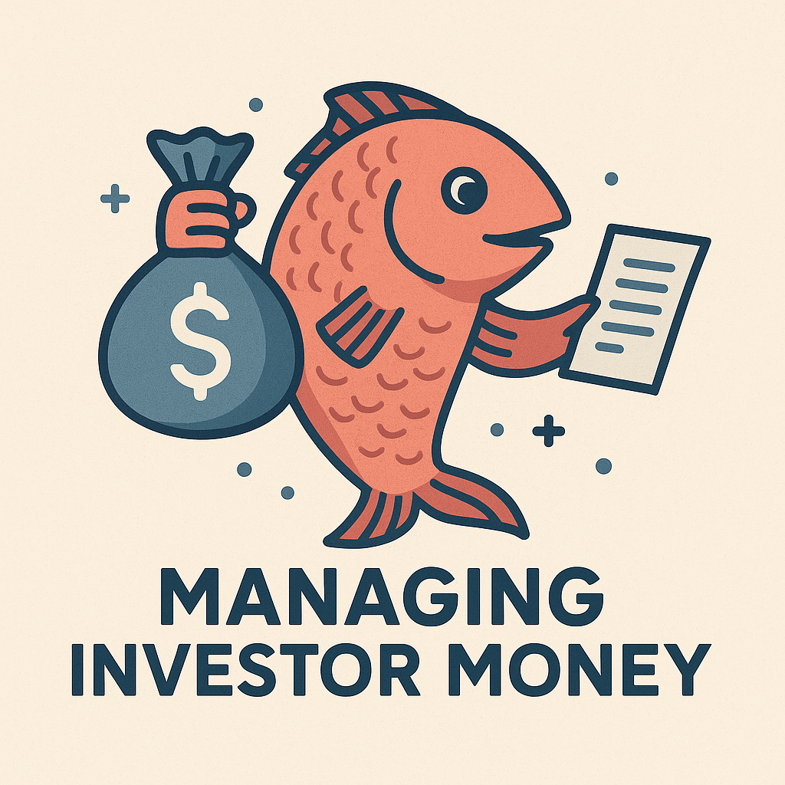

Manage your Money
No credit cards — only verified bank accounts
Funds used only for approved expenses
Transparent reporting and auditability

Slide 20
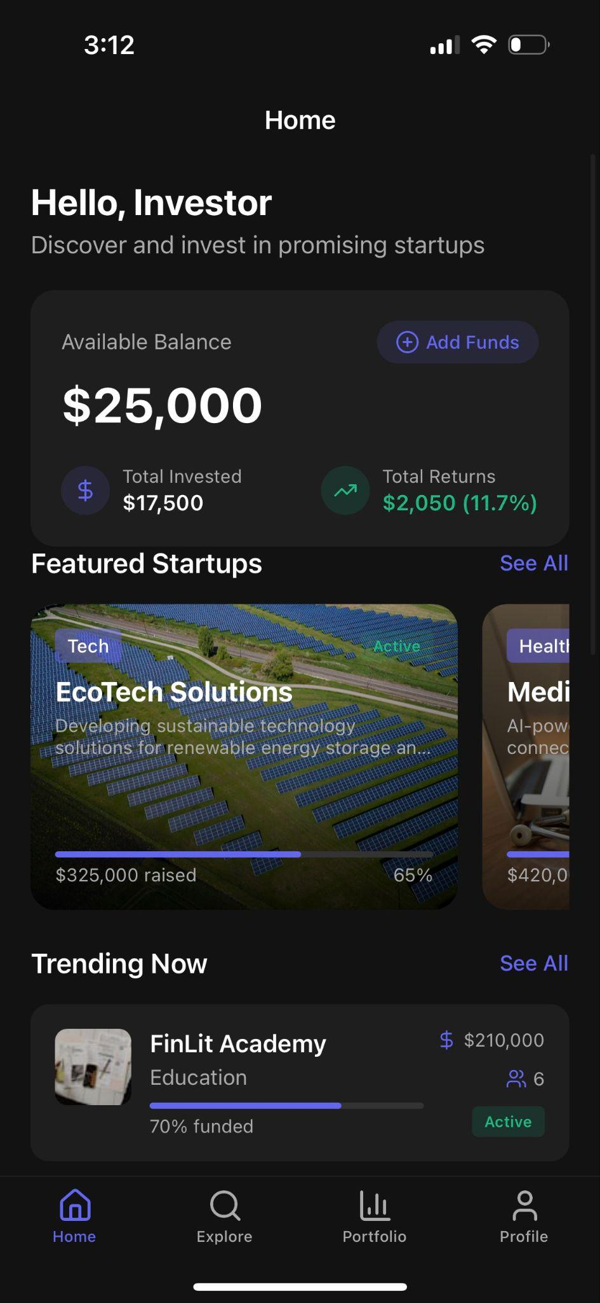
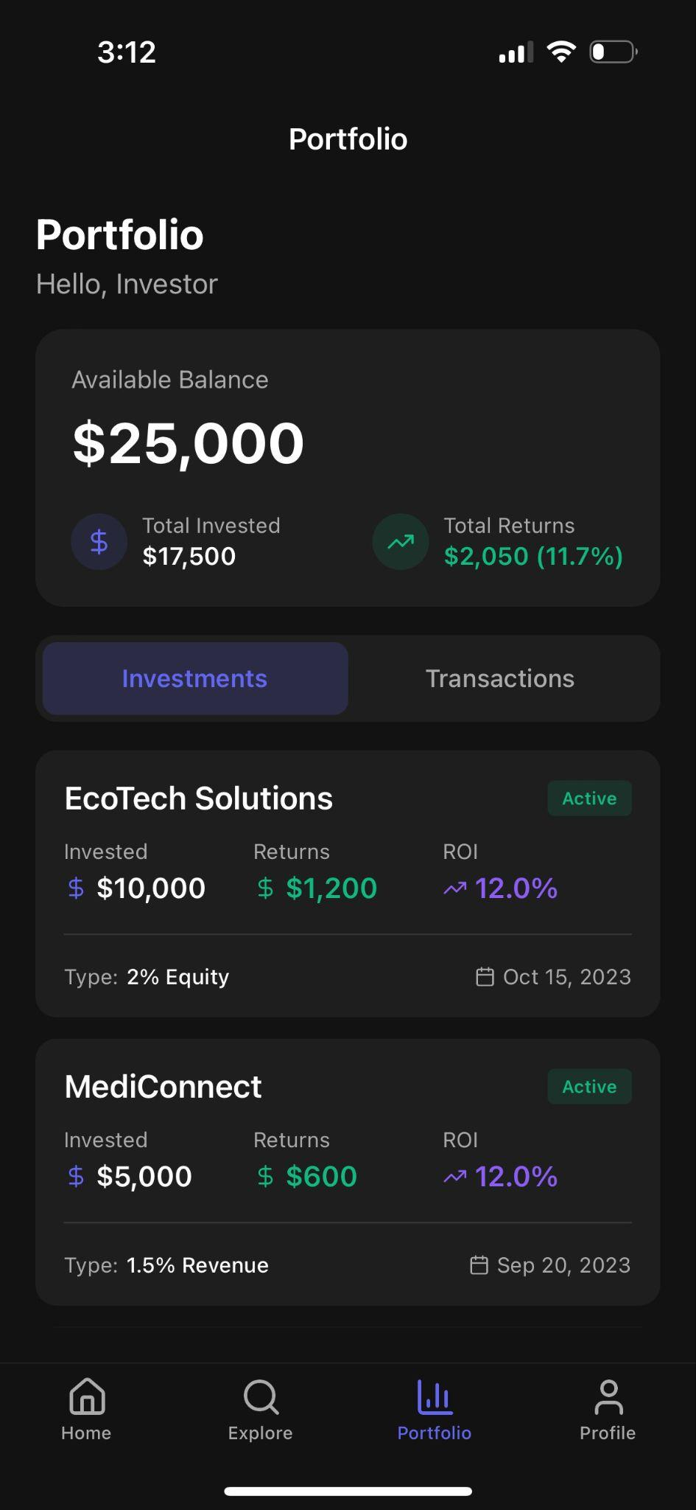
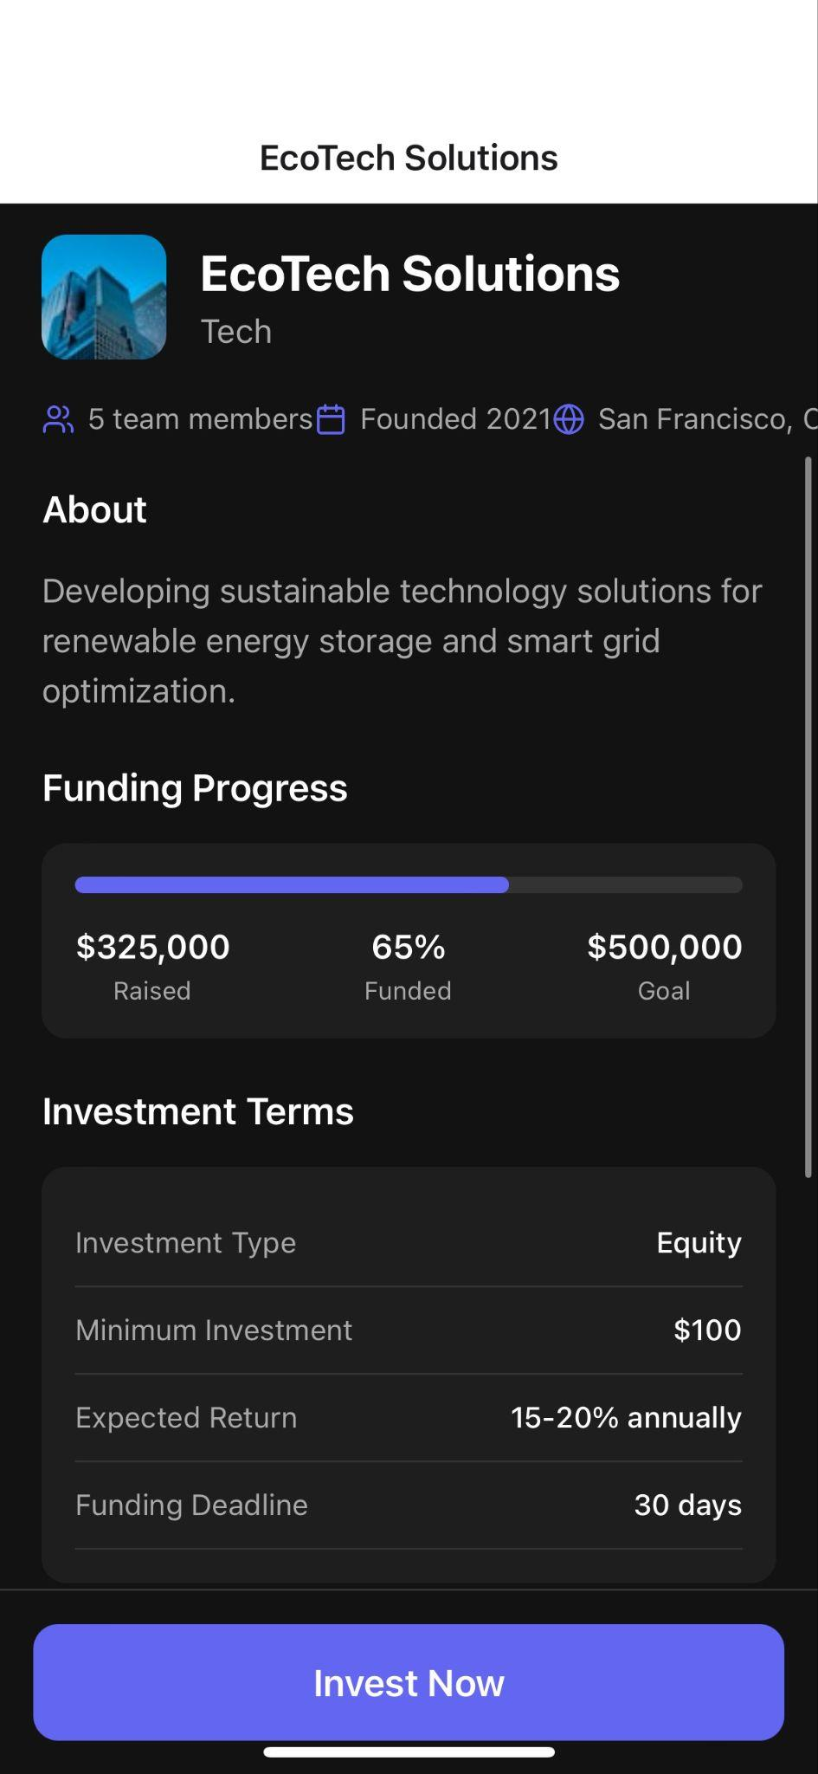
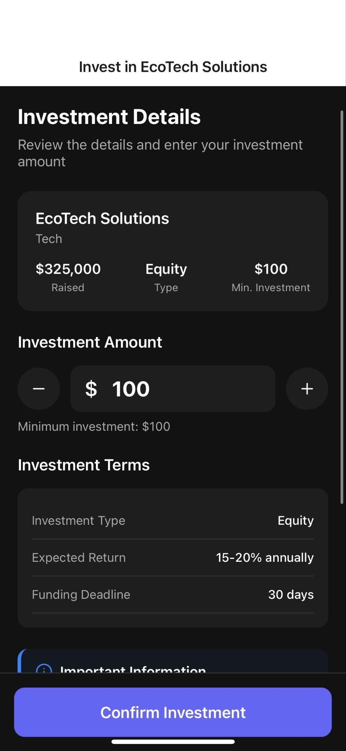

Slide 21
Profit Structure
2-5% on all investor transactions
2-5% on all business revenues
Future plans include operating investment pool as a bank, reinvesting this money

Slide 22
Example Businesses
Tech Companies
Food Trucks
Local Businesses
Video Games

Slide 23
Works Cited
Hayes, A. (2024, October 18). What is venture capital? Definition, pros, cons, and how it works. Investopedia.
https://www.investopedia.com/terms/v/venturecapital.asp
Hood, T. (2024, November 4). Fraud Prevention resources for Startups. Burkland. https://burklandassociates.com/2024/11/04/fraud-prevention-resources-for-startups/
Johnston, M. (2024, June 14). How Robinhood makes money. Investopedia. https://www.investopedia.com/articles/active-trading/020515/how-robinhood-makes-money.asp
Team, T. P. (2024, November 7). Understanding Social Finance for Social Impact. Purppl. https://purppl.com/understanding-social-finance-for-social-impact/
App screenshots generated with help of Rork AI
Images generated with help of Chatgpt

